Slide 1
Services Provided By Internet
Instructor: engr. Hira Akash

Slide 2
Internet
The Internet is a global system of interconnected computer networks that use the standard Internet protocol suite (TCP/IP) to serve billions of users worldwide
It is a network of networks that consists of millions of private, public, academic, business, and government networks, of local to global scope, that are linked by a broad array of electronic, wireless and optical networking technologies.

Slide 3
Brief history of internet
ARPA – Advanced Research Project Agency.
1969 January 2 – started an experimental Computer Network.
Concept – No Server, but equal importance/participation to every computer in the Network.

Slide 4
Service provided by internet
Electronic Mail (e-mail)
World Wide Web
File Transfer Protocol (FTP)
Instant Messaging
News Groups

Slide 5
Electronic mail
Electronic mail, commonly known as email or e-mail, is a method of exchanging digital messages from an author to one or more recipients
An email message consists of three components, the message envelope, the message header, and the message body.
The message header contains control information, including, minimally, an originator's email address and one or more recipient addresses

Slide 6
Different email services
Gmail
Hotmail
Yahoo
MSN

Slide 7
World Wide Web (WWW)
Most important service provided by Internet.
An internet-based hypermedia initiative for global information sharing.
Developed in 1989 by Tim Berners-Lee of the European Particle Physics Lab (CERN) in Switzerland.
For searching information on the Internet
Google
Yahoo
Altavista
Wikipedia

Slide 8
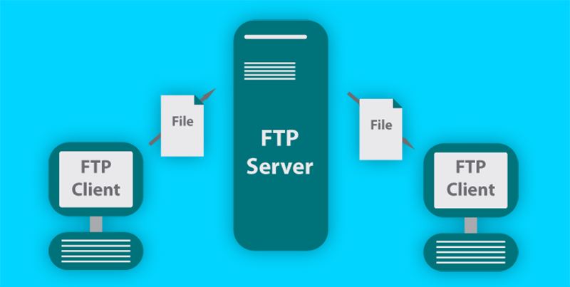
File Transfer Protocol (FTP)
File Transfer Protocol (FTP) is a standard network protocol used to transfer files from one host to another host

Slide 9
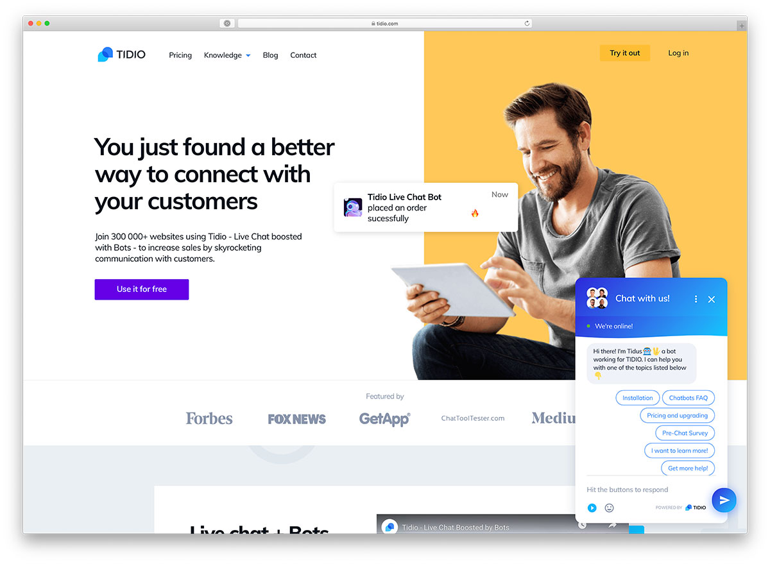
Instant Messaging or Chat
Notifies you when one or more people are online allows exchange of messages and files.
It allows you to join a private chat rooms.
Real time conversation that takes place on a computer Chat room is location on server that permits users to discus topics of interest
Some are the text only others support voice and video

Slide 10
News Groups
Online area in which users conduct written discussion about a particular subject.
Usenet ( collection of all internet newsgroups ).
News server ( computer storing newsgroups msgs ).
Newsreader ( program used to access newsgroups ).
Articles ( a previously entered message ).
Posting ( adding an article to the newspaper ).
Message board ( discussion board; easier to use ).
Blog ( short for the web log; regularly updated ).
For example:
If a newsgroup provides the services to exchange information about current affairs, it will have all the postings related to it.

Slide 11
Social Networking Sites
Social Networking Sites or SNSs are used to build online communication to share ideas , activities ,events and exchange files and pictures.
Facebook, Orkut, Twitter etc., are some of the very popular social networking sites.
These sites are used by the people almost everyday for chatting, playing games and staying connected with each other.

Slide 12
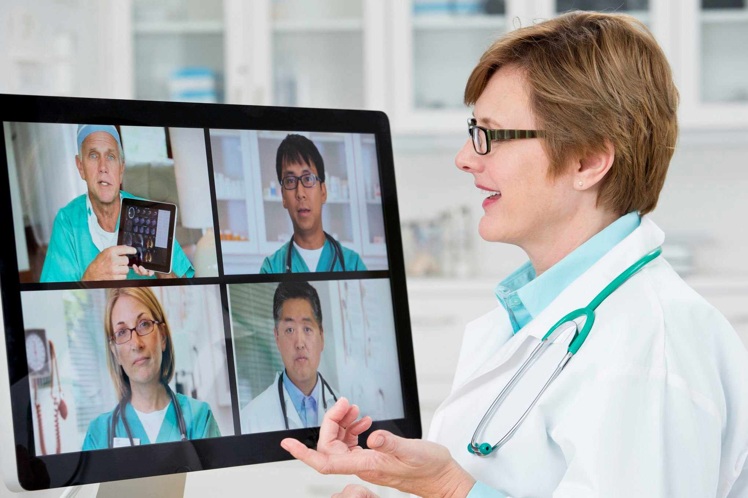
Video Conferencing
Video Conferencing is alive telecommunication between two or more people at different locations.
It is an alternative to face-to-face meetings .
It usually involves audio, video and data.
Devices Required For Video Conferencing
Webcams
Microphones
Speakers
Visual Display
User Interface
Control System

